Slide 1
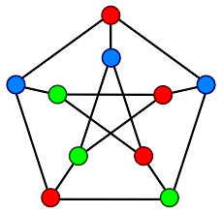
Graph Colouring Problem(GCP)
What is Graph Colouring Problem?
Solve using Backtracking method
Requirement of other algorithms to solve the problem instead of Backtracking

Slide 2
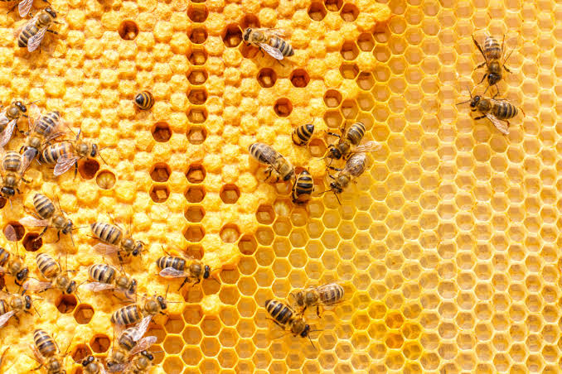
Artificial Bee Colony (Concept)
Types of bees in the hive
Employee
Onlooker
Scout
Their function
Speciality

Slide 3

Artificial Bee Colony(Algorithm)
Initialize
REPEAT
(a) Devote each employed bee to only a single food source;
(b) Create onlooker bees, which eventually follow the employed bees;
(c) Create a scout bee when a food source is exhausted in order to randomly find a new food source;
UNTIL (requirements are met).

Slide 4
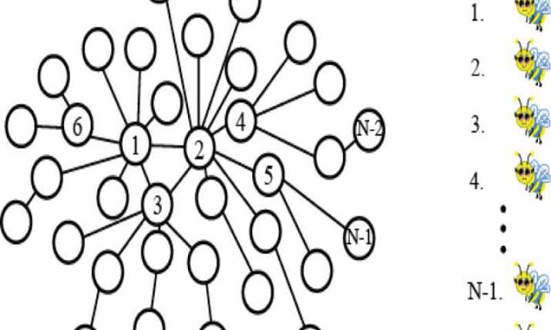
Implementation of ABC algorithm in GCP
Assumptions
Other algorithms required along with ABC
Functions()
Implementing concept of ABC in GCP

